Slide 1
MACHINE LEARNING

Slide 2
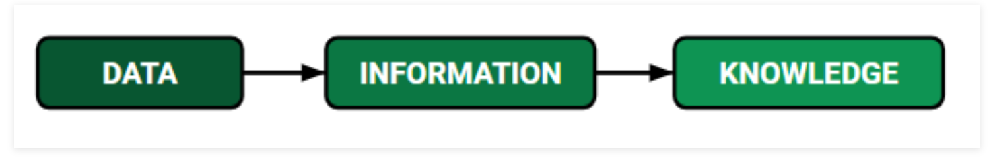
What is Data, Information & Knowledge
DATA : It can be any unprocessed fact, value, text, sound or picture that is not being interpreted and analyzed. Data is the most important part of all Data Analytics, Machine Learning, Artificial Intelligence. Without data, we can’t train any model and all modern research and automation will go vain. Big Enterprises are spending loads of money just to gather as much certain data as possible.
INFORMATION : Data that has been interpreted and manipulated and has now some meaningful inference for the users.
KNOWLEDGE : Combination of inferred information, experiences, learning and insights. Results in awareness or concept building for an individual or organization.
Notes:
Example for Data Importance: Why did Facebook acquire WhatsApp by paying a huge price of $19 billion?
The answer is very simple and logical – it is to have access to the users’ information that Facebook may not have but WhatsApp will have. This information of their users is of paramount importance to Facebook as it will facilitate the task of improvement in their services.
“Data is the New Oil” :P
Next slide : as when ML was discovered

Slide 3
What is AI, ML and DL?
Artificial Intelligence (AI), defined as “the science and engineering of making intelligent machines that have the ability to achieve goals like humans do” in the year 1955.
In short, Artificial Intelligence is human intelligence exhibited by Machines.
Machine Learning (ML) in 1959 as a large sub-field of AI dealing with the field of study that gives computers the ability to learn without being explicitly programmed.
Meaning a single program, once created, will be able to learn how to do some intelligent activities outside the notion of programming. Machine Learning is an approach to achieve Artificial Intelligence.

Slide 4
Deep Learning(DL) Within the machine learning fields, there is an area often referred to as brain-inspired computation. Human brain is one of the best ‘machine’ we know for learning and solving problem.
The main computational element of our brain is neuron. The complex connected network of neurons forms the basis of all the decisions made based on the various information gathered. This is exactly what Artificial Neural Network technique does.

Slide 5
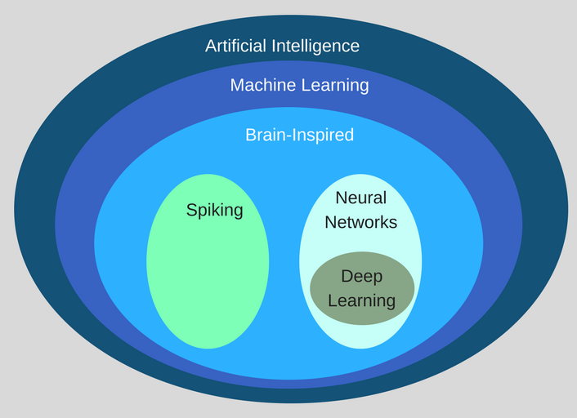
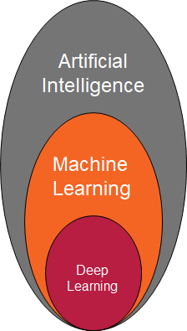
Notes:
artificial intelligence can be loosely interpreted to mean incorporating human intelligence to machines
When a machine completes tasks based on a set of stipulated rules that solve problems (algorithms), such an “intelligent” behavior is what is called artificial intelligence.
ML is a subset of artificial intelligence; in fact, it’s simply a technique for realizing AI.
It is a method of training algorithms such that they can learn how to make decisions.
For example, identifies the type of fruit based on its characteristics: weight and texture
DL algorithms are roughly inspired by the information processing patterns found in the human brain.
The brain usually tries to decipher the information it receives. It achieves this through labelling and assigning the items into various categories.
DL can automatically discover the features to be used for classification, ML requires these features to be provided manually.

Slide 6
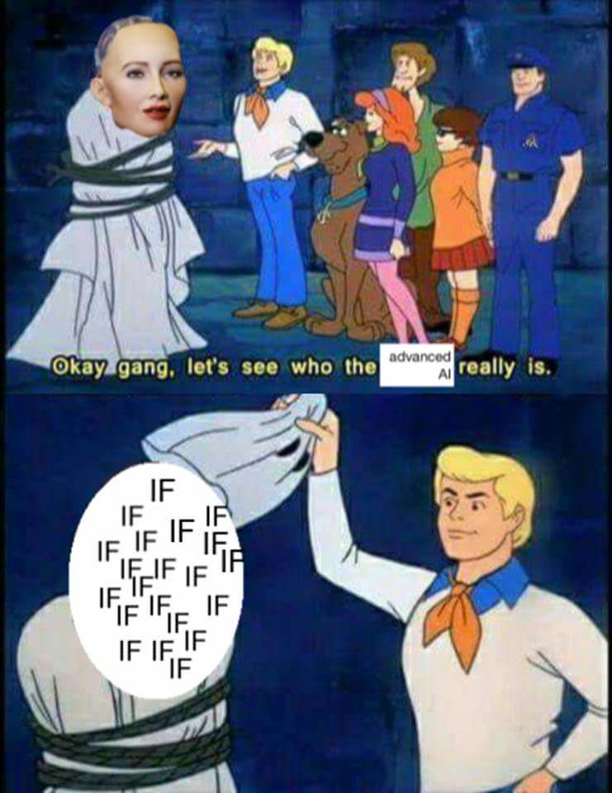

Slide 7
What is machine learning?
In conventional programming we explicitly write what a program should do
Applying statistical analysis to find patterns in data
Developing a model based on the available data
Using the developed model to make highly accurate predictions
Examples: Recommendation engines, self driving cars, OCR, facial recognition etc

Slide 8
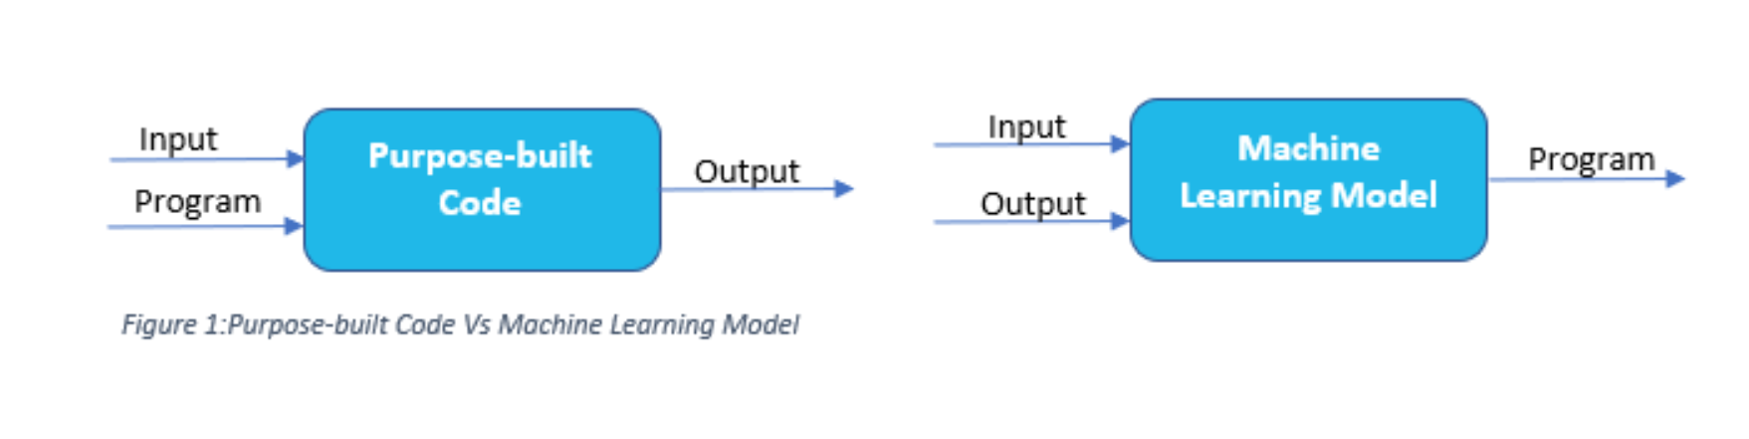
Notes:
This is exactly how humans learn as well. When any kid learns to identify objects/person, we don’t tell them an algorithm/procedure to identify the features and then decide what is it. We simply show them multiple examples of that object and then our human brain automatically identifies the features (sub-consciously) and learns to identify that object. This is indeed what a Machine Learning Model does.

Slide 9
Stages involved
Data collection - Kaggle, crowdsourcing
Data preparation - Missing values, scaling, splitting
Model selection
Training
Evaluation

Slide 10
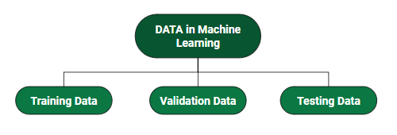
How we split data in ML?
Training Data - The part of the data to train our model.
Validation Data - The part of the data used to do frequent evaluation of the model
Testing Data - This part of the data provides the unbiased evaluation once our model is completely trained.
Notes:
Training Data: This is the data which your model actually sees(both input and output) and learn from.
Validation Data: Fit on training dataset along with improving involved hyperparameters (initially set parameters before the model begins learning). This data plays it’s part when the model is actually training.
Testing Data: Once our model is completely trained, testing data provides the unbiased evaluation. When we feed in the inputs of Testing data, our model will predict some values(without seeing actual output). After prediction, we evaluate our model by comparing it with actual output present in the testing data. This is how we evaluate and see how much our model has learned from the experiences feed in as training data, set at the time of training

Slide 11
Classes of ML algorithms
Supervised ML algorithms - Object recognition
Unsupervised ML algorithms - Identify bowlers and batsmen
Semi-supervised ML algorithms - Speech Analysis
Reinforcement ML algorithms - Chess game
Notes:
Some machine learning methods
Machine learning algorithms are often categorized as supervised or unsupervised.
Supervised machine learning algorithms can apply what has been learned in the past to new data using labeled examples to predict future events. Starting from the analysis of a known training dataset, the learning algorithm produces an inferred function to make predictions about the output values. The system is able to provide targets for any new input after sufficient training. The learning algorithm can also compare its output with the correct, intended output and find errors in order to modify the model accordingly.
Unsupervised machine learning algorithms are used when the information used to train is neither classified nor labeled. Unsupervised learning studies how systems can infer a function to describe a hidden structure from unlabeled data. The system doesn’t figure out the right output, but it explores the data and can draw inferences from datasets to describe hidden structures from unlabeled data.
Semi-supervised machine learning algorithms fall somewhere in between supervised and unsupervised learning,
They use both labeled and unlabeled data for training – typically a small amount of labeled data and a large amount of unlabeled data.
The goal of a semi-supervised model is to classify some of the unlabeled data using the labeled information set.
This method are able to considerably improve learning accuracy. Usually, semi-supervised learning is chosen when the acquired labeled data requires skilled and relevant resources in order to train it / learn from it.
Reinforcement machine learning algorithms is a learning method that interacts with its environment by producing actions and discovers errors or rewards.
Trial and error search and delayed reward are the most relevant characteristics of reinforcement learning.
This method allows machines and software agents to automatically determine the ideal behavior within a specific context in order to maximize its performance.
Simple reward feedback(positive/negative) is required for the agent to learn which action is best; this is known as the reinforcement signal.

Slide 12
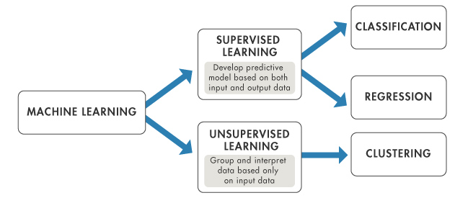
ML Methods

Slide 13
Types Based on Learning ability
Batch Learning
In many cases, we have end-to-end Machine Learning systems in which we need to train the model in one go by using whole available training data. Such kind of learning method or algorithm is called Batch or Offline learning. The following are the main steps of Batch learning methods −
Step 1 − First, we need to collect all the training data for start training the model.
Step 2 − Now, start the training of model by providing whole training data in one go.
Step 3 − Next, stop learning/training process once you got satisfactory results/performance.
Step 4 − Finally, deploy this trained model into production. Here, it will predict the output for new data sample.
Notes:
It is called Batch or Offline learning because it is a one-time procedure and the model will be trained with data in one single batch

Slide 14
2. Online Learning
It is completely opposite to the batch or offline learning methods. In these learning methods, the training data is supplied in multiple incremental batches, called mini-batches, to the algorithm.
Steps of Online learning methods −
Step 1 − First, we need to collect all the training data for starting training of the model.
Step 2 − Now, start the training of model by providing a mini-batch of training data to the algorithm.
Step 3 − Next, we need to provide the mini-batches of training data in multiple increments to the algorithm.
Step 4 − As it will not stop like batch learning hence after providing whole training data in mini-batches, provide new data samples also to it.
Step 5 − Finally, it will keep learning over a period of time based on the new data samples.

Slide 15
Supervised learning: Mathematical Idea
Task of inferring a function from labelled training data
Y = f(X)
where X is the input variable
Y is the output variable
f is the function to be determined

Slide 16
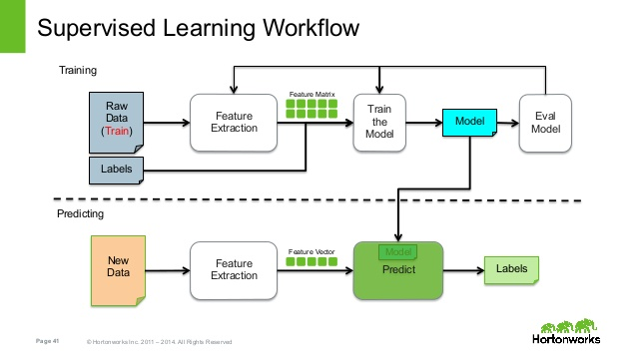
Supervised learning: Workflow

Slide 17
Supervised learning: Types
Classification: A classification problem is when the output variable is a category, such as “red” or “blue” or “disease” and “no disease”
Regression: A regression problem is when the output variable is a real value, such as “rupees” or “weight”

Slide 18
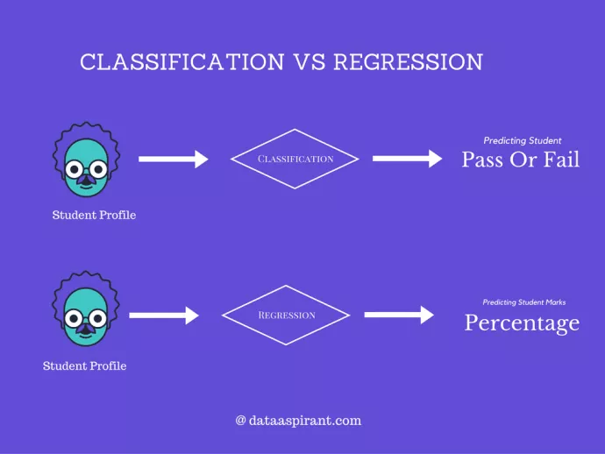
Classification vs Regression

Slide 19
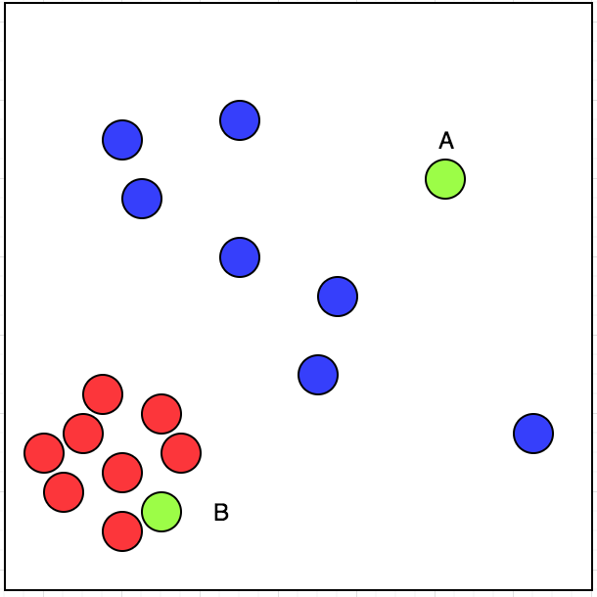
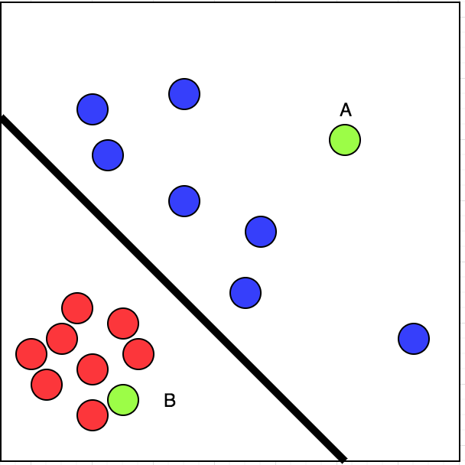
Supervised Learning has input and correct output
(i)
(ii)
Notes:
Let's look at the picture (i):
I have visited the restaurants marked by red circle. The restaurants which I have not visited is marked by blue circle.
Now, If I have two restaurants to choose from, A and B, marked by green colour, which one will I choose?
Simple. We can classify the given data linearly into two parts. That means, we can draw a line segregating red and blue circle.
Let's look at the picture (ii):
Now, we can say with some confidence that chances of my visiting B is more than A. This is a case of supervised learning.

Slide 20
Unsupervised learning
Task of inferring a function to describe hidden structure from "unlabeled" data
Input data (X) alone is available
Output labels (Y) are unavailable
Goal: Model the underlying structure or distribution in the data in order to learn more about the data

Slide 21
Unsupervised learning: Types
Clustering: Discover the inherent groupings in the data, such as grouping customers by purchasing behavior
Association: Discover rules that describe large portions of your data, such as people that buy X also tend to buy Y

Slide 22
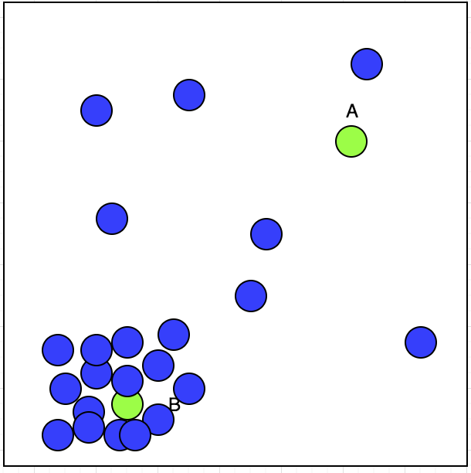
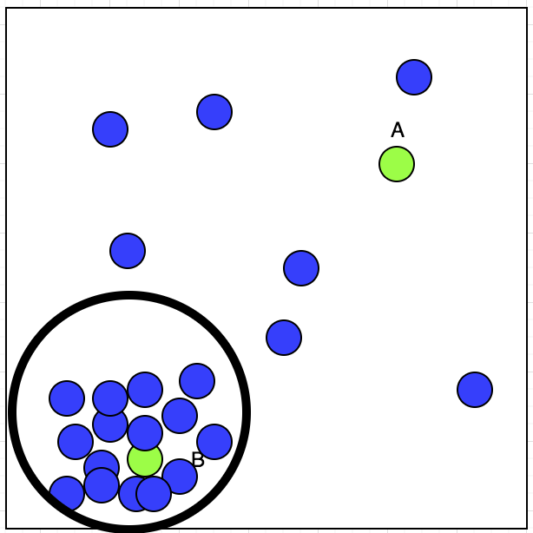
Unsupervised learning has inputs
(i)
(ii)
Notes:
Let's suppose we have a taxi driver who has an option of accepting or rejecting the bookings. We have plotted his accepted booking location on map with blue circle and is shown in picture (i)
Now, Taxi driver has got two bookings A and B; Which one he will accept?
If we observe the plot, we can see that his accepted booking shows a cluster at lower left corner. That can be shown in the picture (ii)

Slide 23
Identify the type of learning involved
Based on a variety of demographic, educational characteristics of students, a scientist wishes to predict if a certain set of students win a coding competition. Which form of learning should she employ?
SUPERVISED LEARNING (CLASSIFICATION)
ABC, a trader wishes to use machine learning to predict the stock prices using historic data. Which type of learning should he use?
SUPERVISED LEARNING (REGRESSION)

Slide 24
Based on past information about spams and filtering in his email account, X wishes to find out if a new incoming email arrives into his Inbox or his spam folder. Identify the type of machine learning involved.
SUPERVISED LEARNING (CLASSIFICATION)
To incorporate targeted marketing in her e-commerce venture, Y wishes to discover groups of customers with similar interests given their profile and purchase details. Which form of machine learning would be most suited for her needs?
UNSUPERVISED LEARNING (CLUSTERING)

Slide 25
ML with Python – Why Python?
Easy to learn
Programmer friendly – simple and elegant
Supports a wide range of ML libraries
Anaconda: https://docs.anaconda.com/anaconda/install/

Slide 26
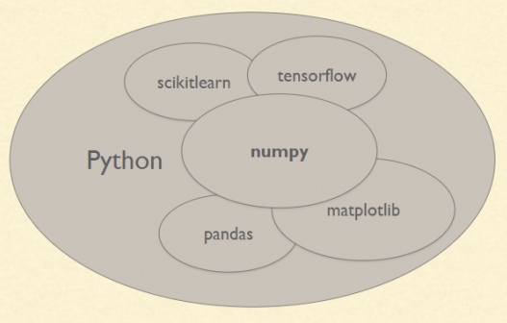
Important python libraries
Numpy
Scipy
Scikit-learn
Pandas
Matplotlib

Slide 27
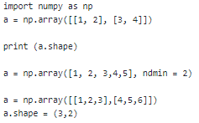
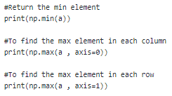
NumPy - Numerical Python
NumPy lets you work with huge, multidimensional matrices and arrays. Also, it provides high-level functions to perform mathematical operations
Notes:
https://becominghuman.ai/an-essential-guide-to-numpy-for-machine-learning-in-python-5615e1758301
https://www.tutorialspoint.com/numpy/numpy_quick_guide.htm#

Slide 28

SciPY
Linear Algebra
Polynomial operation
Integration
Processing Images (Rotate, zoom, filters)
Fast Fourier Transforms - imp. in image processing

Slide 29
Pandas
Reading from files with CSV, XLSX, TXT
Iterating over a data set
Filtering data around a condition
Aligning data and dealing with missing data
Slicing data
DataFrame is a data structure with pandas for dealing with data in a tabular fashion. The rows are observations and columns are variables

Slide 30
Matplotlib
Matplotlib.pyplot is a plotting library used for 2D graphics in python
Problem : read Data.csv
scatter plot age vs salary
Bar graph for number of yes and No

Slide 31
Data Preprocessing
Real world data are generally:
Incomplete: Missing attribute values, missing certain attributes of importance, or having only aggregate data
Noisy: Containing errors or outliers
Inconsistent: Containing discrepancies in codes or names

Slide 32
Rescaling
Transforms features by scaling each feature to a given range.
Calculation : X_std = ( X - X.min ) / ( X.max - X.min )
X_scaled = X_std * (max - min) + min
Default range (0,1)
Sensitive to outliers
Application - Rescaling data has use with neural networks, optimization algorithms and those using distance measures like k-nearest neighbors and weight inputs like regression.
Notes:
use formula for manual calculation and for hands-on make a plot and show the difference
https://scikit-learn.org/stable/modules/generated/sklearn.preprocessing.MinMaxScaler.html
from sklearn.preprocessing import MinMaxScaler
data = [[-1, 2], [-0.5, 6], [0, 5], [1, 15]]
scaler = MinMaxScaler((1,2))
scaler.fit(data)
print(scaler.transform(data))
#or
print(scaler.fit_transform(data))

Slide 33
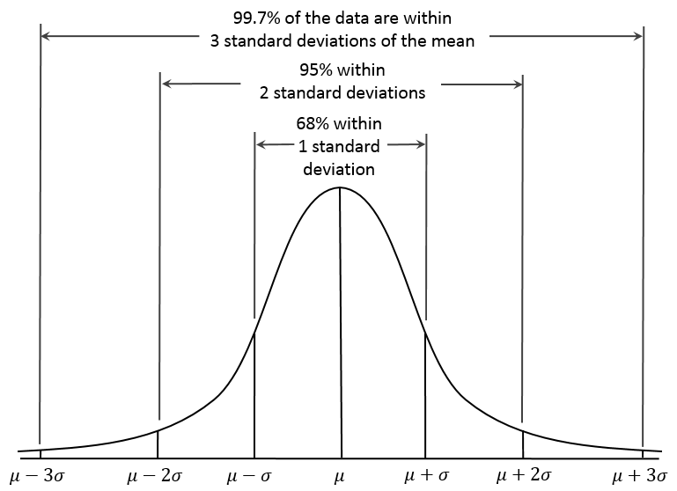
Standardizing
Transformation of attributes into a standard Gaussian distribution with a mean of 0 and a standard deviation of 1.
Calculation : z = (x - mean) / x_std
Application - Support Vector Machines If a feature has a variance that is orders of magnitude larger that others, it might dominate the objective function and make the estimator unable to learn from other features correctly as expected.
Notes:
use formula for manual calculation and for hands-on make a plot and show the difference
https://scikit-learn.org/stable/modules/generated/sklearn.preprocessing.StandardScaler.html#sklearn.preprocessing.StandardScaler.fit
from sklearn.preprocessing import StandardScaler
data = [[0, 0], [0, 0], [1, 1], [1, 1]]
scaler = StandardScaler()
print(scaler.fit(data))
print(scaler.mean_)
print(scaler.transform(data))
#or
print(scaler.fit_transform(data))

Slide 34
Binarizing data
Binarizing data - set feature values to 0 or 1 according to a threshold
Values greater than the threshold map to 1
Values less than or equal to the threshold map to 0
Default threshold of 0, only positive values map to 1.
Application : Eg. offensive words identification, Operation on text count data where the presence or absence of a feature is sufficient rather than a quantified number of occurrences for instance.
Notes:
https://scikit-learn.org/stable/modules/generated/sklearn.preprocessing.Binarizer.html
from sklearn.preprocessing import Binarizer
X = [[ 1., -1., 2.],
[ 2., 0., 0.],
[ 0., 1., -1.]]
transformer = Binarizer().fit(X) # fit does nothing.
transformer
transformer.transform(X)

Slide 35
Replacing missing values
Missing values are imputed by either mean, median or most frequent value of the corresponding columns

Slide 36
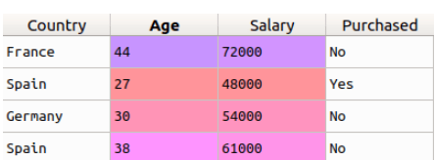

Label Encoder
To convert categorical text data into model-understandable numerical data.
What’s the drawback???
Notes:
Label Encoder and One Hot Encoder are parts of the SciKit Learn library in Python, and they are used to convert categorical data, or text data, into numbers, which predictive models can better understand.
Drawback - since there are different numbers in the same column, the model will misunderstand the data to be in some kind of order, 0 < 1 < 2 or hierarchy, when we clearly don’t have it
>>> from sklearn import preprocessing
>>> le = preprocessing.LabelEncoder()
>>> le.fit(["paris", "paris", "tokyo", "amsterdam"])
LabelEncoder()
>>> list(le.classes_)
['amsterdam', 'paris', 'tokyo']
>>> le.transform(["tokyo", "tokyo", "paris"])
array([2, 2, 1]...)
>>> list(le.inverse_transform([2, 2, 1]))
['tokyo', 'tokyo', 'paris']

Slide 37
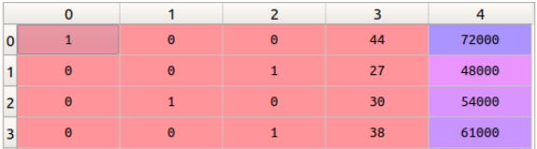
One Hot Encoding
Takes a column which has categorical data, which has been label encoded, and then splits the column into multiple columns.
The numbers are replaced by 1s and 0s, depending on which column has what value
Overcomes the ordering problem of label encoding.
Notes:
from sklearn.preprocessing import OneHotEncoder
onehotencoder = OneHotEncoder(categorical_features = [0])
x = onehotencoder.fit_transform(x).toarray()
specifies which column has to be one hot encoded, [0] in this case. Then we fit and transform the array ‘x’ with the onehotencoder object

